Slide 1
How to Drive Profits higher by developing a CULTURE of Mortgage Planners

Slide 2
A Few of the industry leaders I interviewed
Brian Koss SVP of Countrywide
$5B under leadership
220 originators on his team
$148M in team production in 2005
30 branches and 17 satellites
Jeff May CEO of Cherry Creek Mortgage
$1.73B under leadership
136 originators on his team
40 branches
Pat Casey SVP of SunTrust
$1.5B under leadership
100 originators on his team
4 branches
Dan Trinadad CEO of Partners Mortgage
$1.2B under leadership
60 originators
20 branches
Tom Ward CEO of Majestic Mortgage
$410M under leadership
25 originators on his team
5 satellites
Jim McMahan Division VP of CTX Mortgage
$200M under leadership
23 originators
$72M in team production
4 satellites

Slide 3
Here are the questions I asked…
What are some your ideals of the ultimate mortgage business?
What are some of the most important goals?
What are the most important metrics you measure?
What have been your biggest strategic decisions in the past few years -- best and worst?
What are your goals for retaining top sales talent?
What % of your originators generates 80% of your production?
What % of your team is new to the industry?
What % is new to your company?
How important is creating a culture of Mortgage Planners?
What do you consider the most important technology investments for your business?
Do you have any best practices or keys to success when adopting new technologies within your company?
What do you expect the Constant Prepayment Rate “CPR” to be in 2006?
The answers they gave will affect your business today

Slide 4
I discovered the following 5 PROFIT DRIVERS…
STRATEGY
FOCUS
MEASUREMENTS
PEOPLE
TECHNOLOGY drives profits --- sometimes?

Slide 5
STRATEGY drives profits
Questions:
What are some your ideals of the ultimate mortgage business?
What are some of the most important goals?
VALUE vs. Price
Notes:
What is the actual value of the “sales call” or “mortgage process”

Slide 6
Question: How important is creating a culture of Mortgage Planners?
  “It means everything to our company right now”
  “Absolutely critical, now more than ever”
  “It’s important, humm, it is one of my top 3 origination priorities”
  “It is everything it is our future”
  “#1 – very – perquisite”
  “Huge priority”
Notes:
What is the actual value of the “sales call” or “mortgage process”

Slide 7
Mortgage Planning is everything
Loan Officer
Mortgage Planner
16%-20%
Price
Transaction Speed
Application takers
Sell Loans
Measures Units
Advice
Relationship Value
Lead Advisor
Change lives
Measures Margins and value
6%-9%
Pull-through rate (PTR)
Pull-through rate (PTR)
Notes:
What is the actual value of the “sales call” or “mortgage process”

Slide 8


2006 Best Practice Mortgage Planning Process
How?
What?
Why?
Ultimate Mortgage Practice
WIN Relationship
Mortgage
Planning
Questions
Step 1
Mortgage
Plan
Step 2
Monthly
Mortgage
Review
Step 3
Annual
Equity
Review
Step 4
Residual Income
Wealth and Success
Professional Respect
Pride in your career
OPTIMIZATION Relationship
Quote rates
& fees
1003 &
Good Faith
Estimate
Marketing
Messages
No Annual
Service
Average Mortgage Application Process

Slide 9
Results
Less than 20% of prospect rate shop you
70%+ conversion ratio
Foundation to success
20%+ past client pull-through ratio
1 loan for every 2 annual reviews
Mortgage
Planning
Questions
Mortgage
Plan
Monthly
Mortgage
Review
Annual
Equity
Review
Mortgage Coach’s Mortgage Planning Process
Value
Drivers
Foundation to a unique & valued experience
Critical so that advice is relevant, trusted & respected
Relationship vs. Transaction focused
Provides third party documentation of the tangible the value of advice
Demonstrates ongoing value and maintains top-of-mind awareness
Provides a tangible service vs. just marketing messages
Demonstrates relationships focus
Creates significant long term value by optimizing debt and equity
Reduces non-tax deductible debt

Slide 10
FOCUS drives profit
You can only execute 3-5 objectives per year
  The fewer the better
You need to focus on one BIG goal at a time
  Create annual & quarterly themes

Slide 11
MEASURES drive profit
OUTCOMES > DRIVERS > KPI’s
Profit margin
Comp Month
production
Cost #
Retention rates
Profits per loan
Effectiveness #
Net Promoter
Score (NPS)
Mortgage’s under
Management (MuM)
Pull-through
ratio (PTR)
Notes:
USE COLUME VS ROWS AND CONSIDER ADDING SOME VISUAL GRAPHS AND CONSIDER LESS INFO ON MORE SLIDES

Slide 12
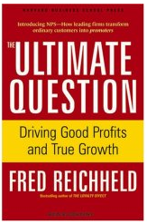
A satisfied customer isn’t enough
Average Loan officers makes $50,000 per year
  20%-40% referrals based
Most successful originators make over $1,000,000 per year
  80% referrals based
http://workingknowledge.hbs.edu/item.jhtml?id=5236&t=leadership
Source: The Ultimate Question, Reichheld, 2006

Slide 13
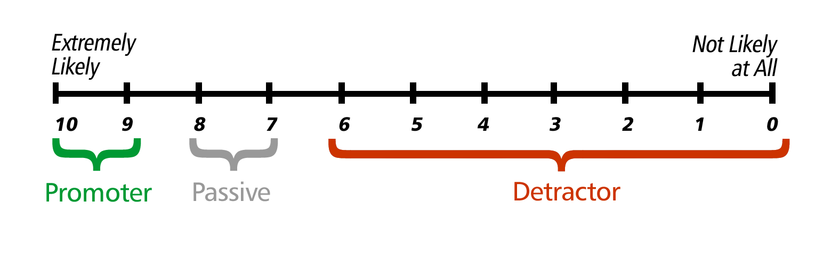
The Ultimate Question
“How likely is it that you would recommend our company to friends or colleagues?”
Net Promoter Score (NPS)
P - D = NPS
Source: The Ultimate Question, Reichheld, 2006

Slide 14
Select NPS Stars
Intuit 58%
Cisco 57%
Federal Express 56%
Southwest Airlines 51%
American Express 50%
Commerce Bank 50%
Dell 50%
Adobe 48%
Electronic Arts 48%
USAA 82%
HomeBanc* 81%
Harley-Davidson 81%
Costco 79%
Amazon 73%
Chick-Fil-A* 72%
Ebay 71%
Vanguard 70%
SAS 66%
Apple 66%
* All NPS statistics are based on Bain or Satmetrix surveys with the exceptions of Intuit, Chick-fil-A, and HomeBanc. For these firms, we used data that they provided. Their data was gathered in a reasonable (but not perfectly equivalent) fashion.
Source: The Ultimate Question, Reichheld, 2006

Slide 15
PEOPLE drive profit
Question: What have been your biggest strategic decisions in the past few years -- best and worst?
The best and worst decisions evolve around people
80/20 rule isn’t good enough
  The best of the best are at 80/50
Hire and fire based on values
  Value vs. Price culture
  Transaction mindset vs. Relationship mindset
Keep your performance review simple yet consistent

Slide 16
The GE Model
Hits the numbers
High/Low
High/High
If you would NOT
enthusiastically rehire then fire
Has the right VALUES and skills
Low/Low
Low/High

Slide 17
TECHNOLOGY drives profit - SOMETIMES
Question: Do you have any best practices or keys to success to adopt new technologies with your company?
“Need user buy-in” and then “Burn the boats”
“Create a 1 year plan with 3-4 milestones”
“Measure results and then share highlights to increase motivation and adoption”
“Identify power users and conduct best practice sessions/workshops”
“Communicate > Communicate > Communicate”

Slide 18
5-Steps to achieving success with technology
What?
How?
Why?
First 60 Days
Strategic
Understanding
First 30 Days
WIN Relationship
Financial Success
Plan
Implement
Reinforce
Optimize
OPTIMIZATION Relationship
1st Day
Critical

Slide 19
Mortgage Coach’s Strategic Services
Planning
Strategic
Understanding
Implement
Reinforce
Optimize
Business Requirements Review
Custom Performance and Learning Plan
Industry leader recorded sessions
White papers
Industry events
Case studies
Train the trainers workshop
Custom training
Deployment assist
Virtual Training
New capabilities workshop
Custom recorded sessions
Case studies
Custom Best Practice briefings
Best Practices session
Power user briefings
Case study sharing

Slide 20
STOP doing loans… START BUILDING WEALTH

